Slide 1

COVID-19 PREDICTION AND IDENTIFICATION WITH MACHINE LEARNING

Slide 2



Team
Sri Charan Reddy Nannuri
Student ID 700747879
Bharath Chandra Tangallapalli
Student ID 700745203
Karishma Shaik
Student ID 700744936

Slide 3
Role/Responsibilities and Contribution in project
Bharath Chandra Tangallapalli
Student ID 700745203
Karishma Shaik
Student ID 700744936
Sri Charan Reddy Nannuri
Student ID 700747879
Implementation of machine learning algorithm and find the Covid19 disease identification.
Analyze the prediction results.
Documentation and PPT.
Dataset Collection from the web source Kaggle.
Task Analysis of the Covid19 disease with data analytics of machine learning.
Documentation and PPT.
Project initial study
Design of the project workflow
Documentation and PPT.

Slide 4
Motivation
Corona Virus is the respiratory virus found in the world in the year of 2019 and it was names as covid19. In this project, we take the covid19 patient records and pass into the machine learning algorithm known as Logistic Regression algorithm.
The Machine learning algorithm will be the python-based application which contributes to find out the Covid19 disease at the early stage.
It will be helpful for the human to detect disease at early stage and to take necessary treatments in the correct time to save life.

Slide 5
Objectives
The objective of Covid19 disease identification with machine learning is to detect the Covid19 disease in the early stage itself with the available attributes.
In this work, the dataset containing the Covid19 disease dataset will be taken into consideration. The pre-processing will be applied into the dataset and the noisy and null value data will be removed from the dataset.
After that data will be analyzed and visualized for further processing. The Machine learning algorithm will be chosen to make the prediction for the given data attributes.
The dataset will be divided into two parts. The first part of dataset is 70% taken to provide training to the Machine learning algorithm and the remaining 30% of data is taken to testing part.

Slide 6
Related Work
Dataset collection: The information about the Covid19 disease dataset with different types of attributes are collected from different type of patients.
Data Cleaning: The large dataset contains more noisy and improper data which have to be pre-processed to produce the quality dataset for further pruning. The data is cleaned and processed with initial stage of removing the null values.
Data Analysis: Exploratory analysis is a process to explore and understand the data and data relationship in a complete depth so that it makes feature engineering and machine learning modeling steps smooth and streamlined for prediction.
Machine learning Modeling: It helps to find the best algorithm with the best hyper parameters to achieve maximum accuracy. The dataset is split into 2 variants. 70% of records are taken as training data and the remaining 30% of dataset is applied to testing which helps to predict the process.
Report: The Data is visualized based on the output of the Machine Learning algorithm and the data is mapped with different types of graphs to analyze and visualize the exact data to the user for the prediction.
SYSTEM ARCHITECTURE
Data preprocess
Covid19 disease Dataset
Data Cleaning
Training, test data
Covid19 Disease prediction results
Machine Learning Algorithm implementation

Slide 7
Problem Statement
The Corona Virus (Covid-19) is the major threating virus to the human being. The identification of the virus is the major difficult problem even with the help of technology development.
The manual prediction with the help of the reports taken in the medical industry also unable to predict the exact result in covid19.
In most of cases the negative cases identified in the present will gets positive within few duration because of false prediction in the early days.
COVID-19 mainly damages the respiratory system, importing great significance to respiratory rehabilitation and physical therapy interventions.
The prediction of covid19, only some few attributes are taken, and it provides less accuracy level in finding the covid19 virus. The accuracy level of findings is still the challenging task in prediction.

Slide 8
Proposed Solution
The project evaluation can be tested with the Machine learning algorithm prediction results. Since the Logistic Regression algorithm will be used to predict the disease, the accuracy of the algorithm result will be helpful to evaluate the results. The accuracy score of the algorithm in the Covid19 disease identification helps to evaluate the dataset.
Tool Used: Google Colab Python Tool.
The data has been analyzed based on the body temperature, oxygen level, blood pressure and other symptoms, the predicted result of the status is displayed as positive or negative
The predicted result of current status is displayed as recovered, hospitalized or death. The predicted result of symptoms is displayed as very high, high, moderate, low, very low and the accuracy has been calculated.

Slide 9
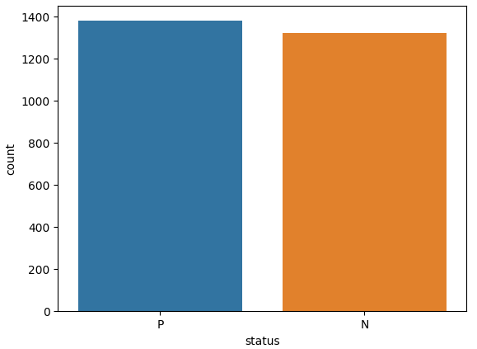
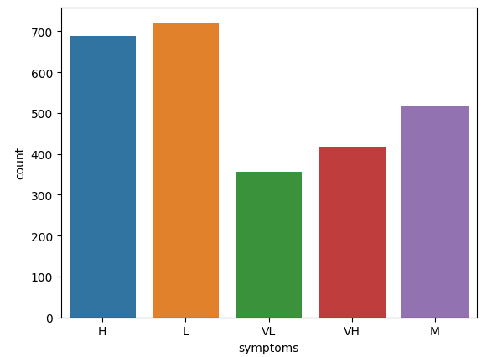
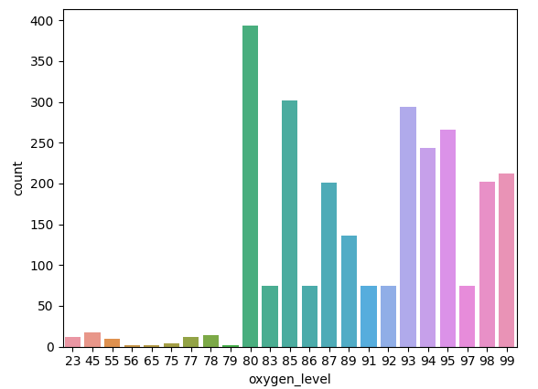
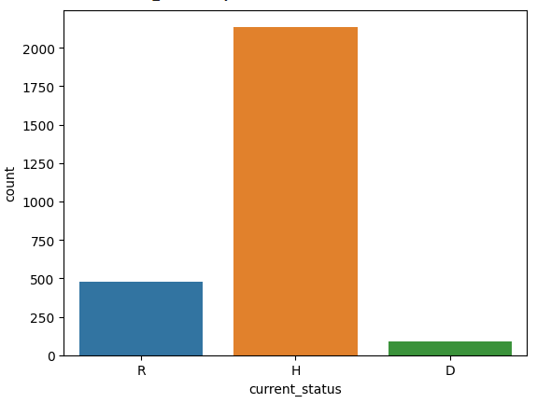
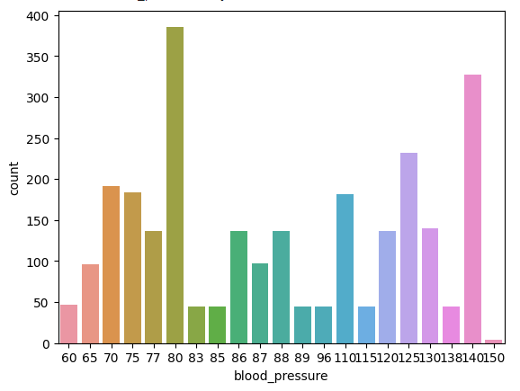
Simulations
Analysis of the positive or Negative
Analysis of the Symptoms
The count of oxygen_level_range of the patients
Analysis of the Recovered, Hospitalized, or Death
Analysis of the Blood pressure

Slide 10
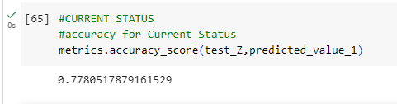
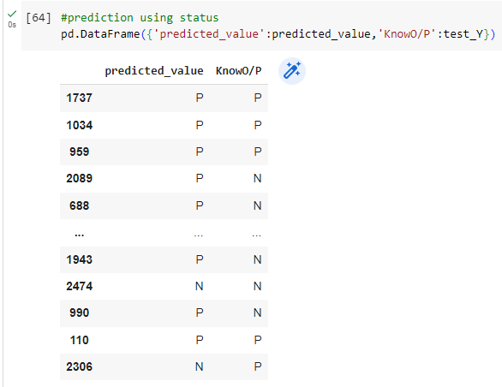
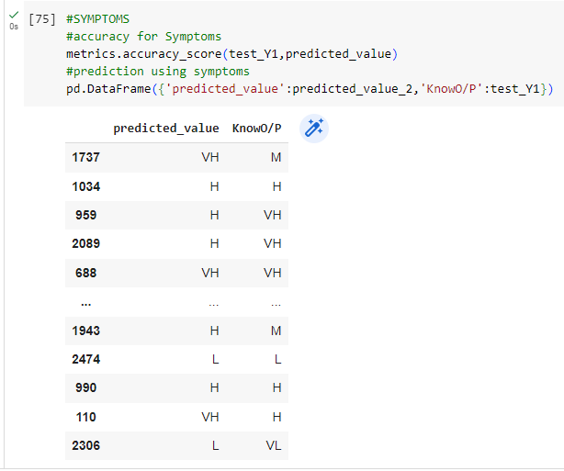
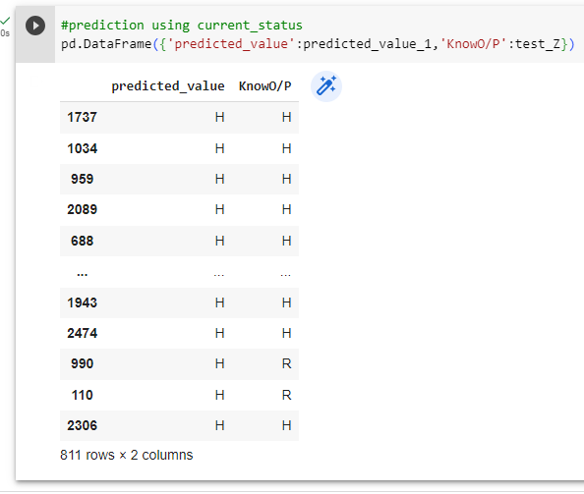
Results
Accuracy
Predicted Values of Covid results
Predicted Values of Covid symptoms
Predicted Values of Hospitalization

Slide 11
Reference
Coronavirus Disease (COVID-19) - events as they happen. Library Catalog: www.who.int.
Countries where Coronavirus has spread - Worldometer. Library Catalog: www.worldometers.info.
COVID-19 situation reports. Library Catalog: www.who.int.
Diagnosis of covid-19 and its clinical spectrum dataset. https://kaggle.com/einsteindata4u/covid19
WHO Director-General’s remarks at the media briefing on 2019-nCoV on 11 February 2020. Library Catalog: www.who.int.
Support Vector Machine Machine learning algorithm with example and code, January 2019. Library Catalog: www.codershood.info Section: Machine learning.
Ali Al-Hazmi. Challenges presented by MERS corona virus, and SARS corona virus to global health. Saudi journal of biological sciences, 23(4):507–511, 2016. Publisher: Elsevier.
Sina F Ardabili, Amir Mosavi, Pedram Ghamisi, Filip Ferdinand, Annamaria R Varkonyi-Koczy, Uwe Reuter, Timon Rabczuk, and Peter M Atkinson. Covid-19 outbreak prediction with machine learning. Available at SSRN 3580188, 2020.
Hiba Asri, Hajar Mousannif, Hassan Al Moatassime, and Thomas Noel. Using machine learning algorithms for breast cancer risk prediction and diagnosis. Procedia Computer Science, 83:1064–1069, 2016.
Taiwo Oladipupo Ayodele. Types of machine learning algorithms. New advances in machine learning, pages 19–48, 2010.
Taiwo Oladipupo Ayodele. Types of machine learning algorithms. New advances in machine learning, pages 19–48, 2010. Publisher: InTech.
David W Bates, Suchi Saria, Lucila Ohno-Machado, Anand Shah, and Gabriel Escobar. Big data in health care: using analytics to identify and manage highrisk and high-cost patients. Health Affairs, 33(7):1123–1131, 2014..
Hetal Bhavsar and Amit Ganatra. A comparative study of training algorithms for supervised machine learning. International Journal of Soft Computing and Engineering (IJSCE), 2(4):2231–2307, 2012.
Rich Caruana and Alexandru Niculescu-Mizil. An empirical comparison of supervised learning algorithms. In Proceedings of the 23rd international conference on Machine learning, pages 161–168, 2006.
https://colab.research.google.com/
https://www.tutorialspoint.com/google_colab/what_is_google_colab.htm
https://www.codingforentrepreneurs.com/courses/python-google-colab-sheets-drive/

